Slide 1
Weight :
A weight represent the strength of the connection.
While building and training neural networks, it is crucial to initialize the weights appropriately to ensure a model with high accuracy.
Weight initialization techniques :
i) Zero initialization
ii)Random intialization
a)He
b)Xavior / Glorot

Slide 2
i)Zero initialization :
As the name suggests, all the weights are assigned zero as the initial value is zero initialization.
This kind of initialization is highly ineffective as neurons learn the same feature during each iteration.
So the learning also accuracy is not good.
Drawbacks :
Zero initialization causes the neuron to memorize the same functions almost in each iteration.

Slide 3
ii)Random Initialization :
In an attempt to overcome the shortcomings of Zero or Constant Initialization, random initialization assigns random values except for zeros as weights to neuron paths.
This technique tries to address the problems of zero initialization since it prevents neurons from learning the same features of their inputs since our goal is to make each neuron learn different functions of its input and this technique gives much better accuracy than zero initialization
Drawbacks
However, assigning values randomly to the weights, problems such as Overfitting, Vanishing Gradient Problem, Exploding Gradient Problem might occur.

Slide 4
a)He intialization:
He Uniform Initialization is suitable for layers where ReLU activation function is used
b)Xavior / Glorot:
Xavier initialization works better for layers with sigmoid activation.
It is default weight initializer
https://www.tensorflow.org/api_docs/python/tf/keras/initializers/Identity

Slide 5
Bias
purpose of the bias term is to shift the position of the curve left or right to delay or accelerate the activation of a node.
We can able to change bias value in neural network by using bias_initializer.
Default bias value is 1.

Slide 6
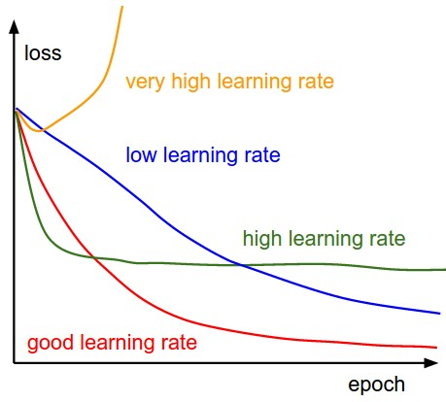
Learning rate
The learning rate is a tuning parameter in an optimization algorithm that determines the step size at each iteration while moving toward a minimum of a loss function.

